Slide 1
Mechanism Design for Keyword Auction
Wenjin Rong
For CUHK, 2014. 09. 05

Slide 2
Two Questions
Who like advertising?
What kind of advertising do you like?

Slide 3
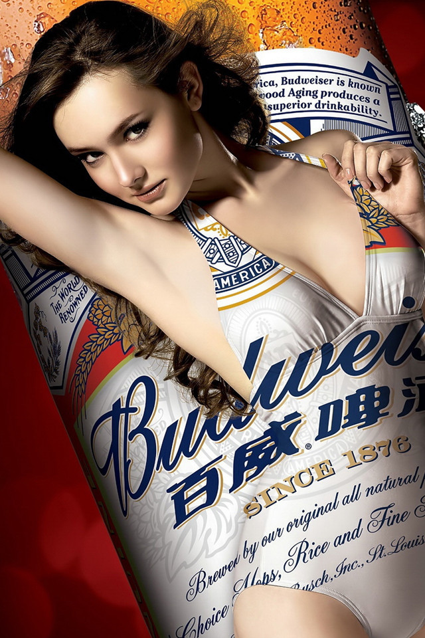
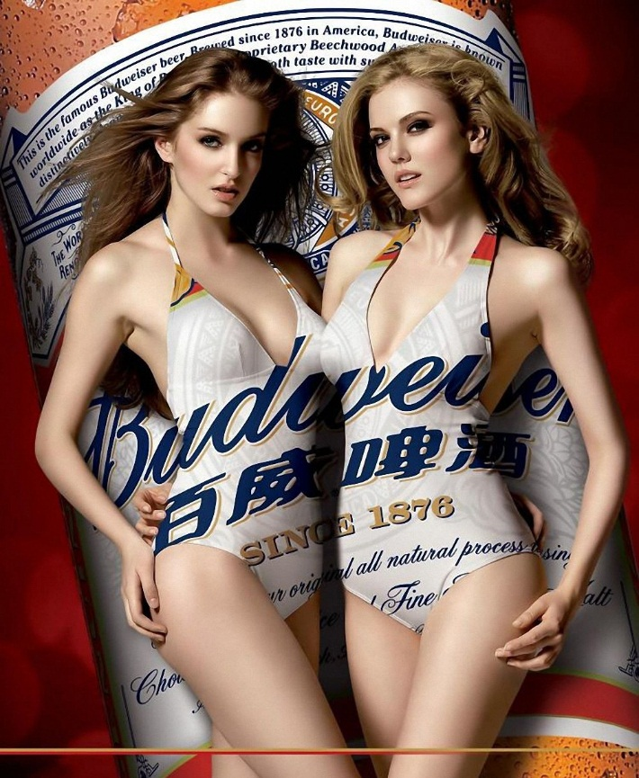
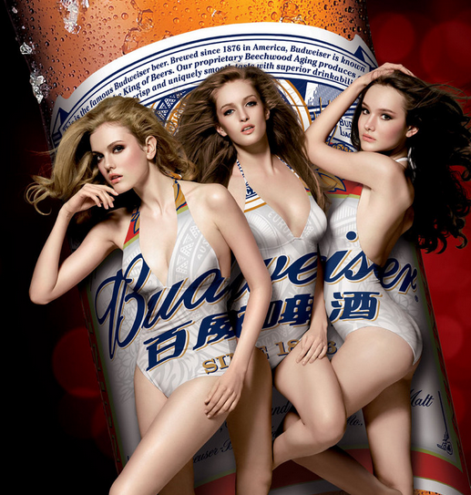
Some are Beautiful

Slide 4
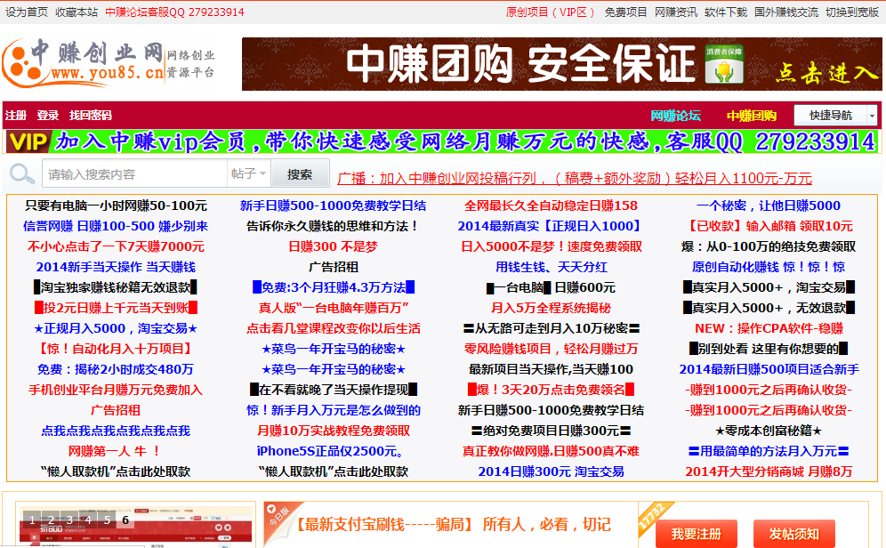
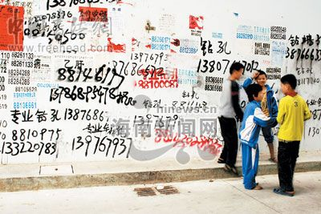
Some other are annoying

Slide 5
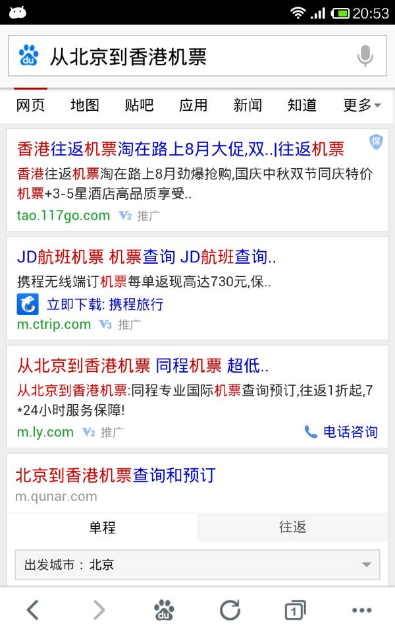

What topic is today’s talk?
How to create “beautiful” ads?
√
Beautiful _ Good Looks: Branding Ads
Beautiful _ Real Needs: Targeted Ads

Slide 6

Computational Advertising
What is Computational Advertising
Find the "best match" between a given user in a given context and a suitable advertisement .
—— Broder and Dr. Vanja，2011
What is Baidu?
Baidu is a high-tech company with mission to provide the best way for people to find information.
Ads
Best Match ∈ Baidu Mission

Slide 7


Advertising is A Kind of Matching
Says What
In Which Channel
Who
To Whom
Feedback
With What Effects
Lasswell, 1948, The Structure And Function Of Communication In Society

Slide 8
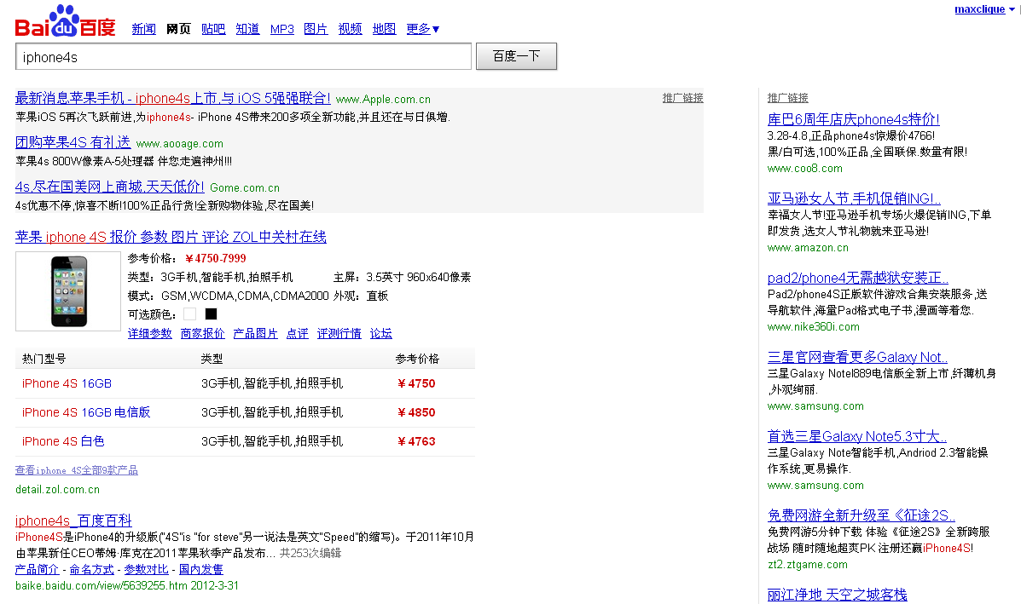
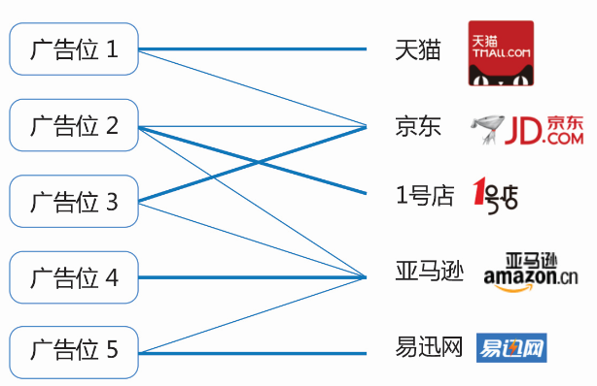
Perfect Matching in Bipartite Graphs
Ads slots
Slot 1
Slot 2
Slot 3
Slot 4
Slot 5
Tutte, 1947, A Ring In Graph Theory; Hall, 1935, On Representatives Of Subsets

Slide 9
Efficient Matching
Advertisers' Value Matrix
Efficient Matching：Maximum sum of each advertisers' Value
 | Tao | Dong | Hao | Ya
Slot 1 | 12 | 8 | 7 | 4
Slot 2 | 4 | 7 | 5 | 3
Slot 3 | 2 | 6 | 2 | 2
12+6+5=23
But this result is unstable if there is no any constraint for advertisers.
Slot 1
Tao
Slot 2
Dong
Slot 3
Hao

Slide 10
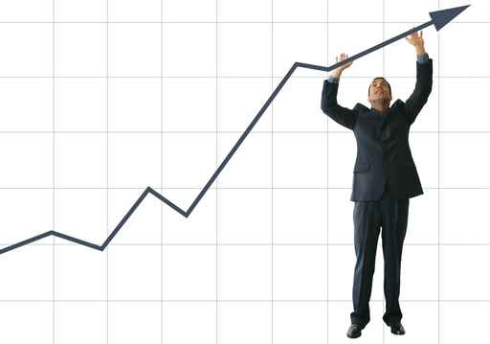
Market Clearing Price
Value Matrix、Profit Matrix and Price
 | Price | Tao | Dong | Hao | Ya
Slot 1 | 6 | 12（6） | 8（2） | 7（1） | 4（-2）
Slot 2 | 3 | 4（1） | 7（4） | 5（2） | 3（0）
Slot 3 | 1 | 2（1） | 6（5） | 2（1） | 2（1）
Price not to Clearing Market
 | Price | Tao | Dong | Hao | Ya
Slot 1 | 3 | 12（9） | 8（5） | 7（4） | 4（1）
Slot 2 | 2 | 4（2） | 7（5） | 5（3） | 3（1）
Slot 3 | 1 | 2（1） | 6（5） | 2（1） | 2（1）
Demange et al, 1986, Multi-item Auction.

Slide 11
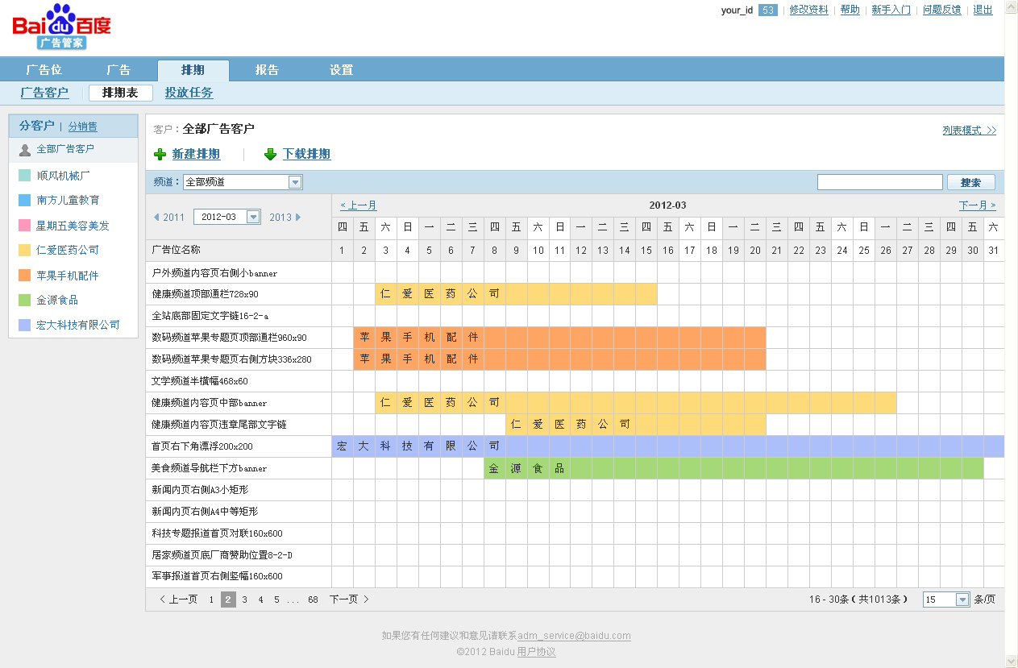
Advertisement Scheduling System：广告管家
date
Ads Slots

Slide 12
VCG Realizes Market Values
In Tao case：
1) When Tao is absent, all the other advertisers’utility is
4.6×0.5+1.8×0.2+1×0.1=2.76
2) When Tao is present, all the other advertisers’utility is
4.6×0.2+1.8×0.1+1×0=1.1
3) The difference of both 1) and 2) is
2.76-1.1=1.66
4) So Tao must pay
1.66/0.5=3.32
for each click-through.
 | Click-Through Rate(CTR)
Slot 1 | 0.5
Slot 2 | 0.2
Slot 3 | 0.1
Advertisers | Values
Tao | 5
Dong | 4.6
Hao | 1.8
Ya | 1
 | VCG
Distribution | Slot goes to advertiser by bids
Payment | P_Tao=3.32
 | P_Dong=1.4
 | P_hao=1
Vickrey, 1961, Counterspeculation，Auctions and Competitive Sealed Tenders
Clarke, 1971, Multipart Pricing of Public Goods
Groves, 1973, Incentives in Teams

Slide 13
Generalized English Auction
 | CTR
Slot 1 | 0.5
Slot 2 | 0.2
Slot 3 | 0.1
0
6
0.5
5.5
1
5
1.5
Advertisers | Value
Tao | 5
Dong | 4.6
Hao | 1.8
Ya | 1
bid | Payment | rank
- | 3.32 | Slot 1
3.32 | 1.4 | Slot 2
1.4 | 1 | Slot 3
1 | 0
4.5
2
4
2.5
3.5
3
Bergemann and Morris, 2004, Robust Mechanism Design

Slide 14
Deferred Acceptance
W2>W1>W3
M1>M2>M3
W2>W1>W3
M1>M2>M3
M1
W1
W1>W2>W3
M3>M1>M2
W1>W2>W3
M3>M1>M2
W1>W2>W3
M2
W2
M3>M1>M2
W1>W2>W3
W1>W2>W3
M1>M2>M2
M3
W3
Shapley and Shubik ，1972，The Assignment Game I: The Core

Slide 15

Generalized Second Price Auction(GSP)
Advertisers | value
A | 5
B | 4
C | 2
5
Rank=1
CPC=4
Slots | CTR
1 | 0.1
2 | 0.05
b=(3, 2, 1) is a Nash equilibrium.
But B can envy A:
  if B replace A in slot 1, his payoff is (4-2)×0.1=0.2 > (4-1)×0.05=0.15
  Effective way to let off stream is raising bids. For example ,B raises his bid from $2 to $2.5：
  if B replace A, his payoff is (4-2.5)×0.1=0.15
  so B should not want to “exchange” with the A , We call such vectors of bids “Locally Envy-Free.”.
4
Rank=2
CPC=2
2
Rank=Nothing
CPC=0
Edelman et al，2005，Internet advertising and the generalized second price auction: Selling billions of dollars worth of keywords

Slide 16
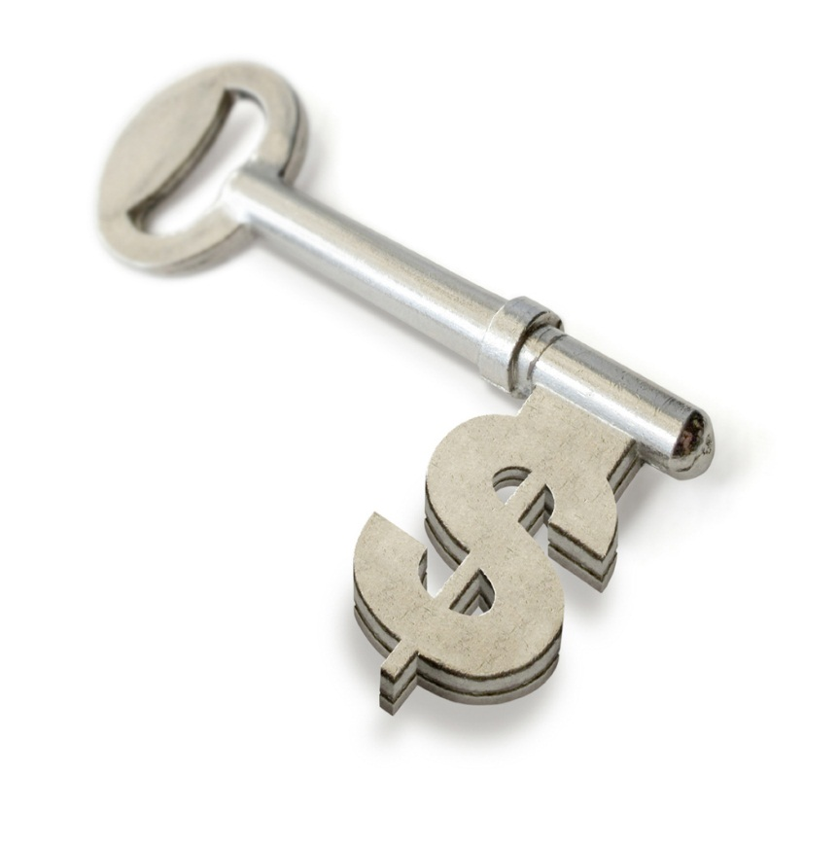
Weighted GSP
Separation of CTR： CTR_{i j}= q_{i} ×e_{j}
quality effect
position effect
Weighted GSP
  Bid: Each advertiser bids an amount b_{a}
  Rank： Advertisers are ordered by q_{a}b_{a}
  b₁ q₁> b₂ q₂>…> b_{m} q_{m}
  Price： p_{s} q_{s}= b_{s+1} q_{s+1}, Solving for p_{s} we have
Varian，2007，Position auctions

Slide 17
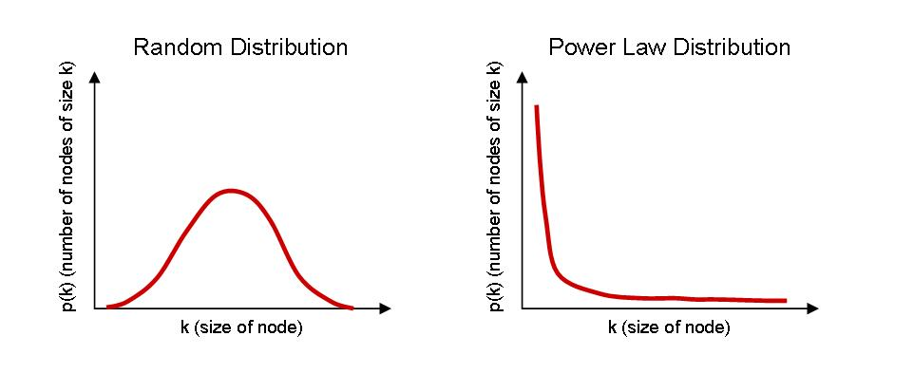

CTR Prediction
Logistic Regression Model
Problems:
Deep Learning
Hinton & Salakhutdinov , 2006，Reducing the dimensionality of data with neural networks
Bengio & LeCun, 2007, Scaling learning algorithms towards AI

Slide 18
Unified Auction
Unified Auction
Baidu
Advertiser
User
Phoenix Nest
Modeling User Experience
wGSP Auction
max sum(f_{n}(x_{n}))
  s.t. sum(x_{n}) <= ue_thr
Abrams & Schwarz, 2008, Ad Auction Design and User Experience

Slide 19
Economics tell advertiers how to bid
No. (k) | Bid （B） | Clicks (CLK) | Charge (CH) | ACP =Charge/Clicks | ΔCH =CH_{k}-CH_{k+1} | ΔCLK =CLK_{k}-CLK_{k+1} | MFC =ΔCH/ΔCLK
1 | 2 | 480 | 743 | 1.55 | 344 | 128 | 2.69
2 | 1.6 | 352 | 399 | 1.13 | 170 | 102 | 1.67
3 | 1.3 | 250 | 229 | 0.92 | 81 | 70 | 1.16
4 | 1 | 180 | 148 | 0.82 | 28 | 20 | 1.40
5 | 0.8 | 160 | 120 | 0.75 | - | - | -

